Slide 1


21st African Water Association International Congress & Exhibition and
The 7th International Faecal Sludge Management Conference
Sustainable safe drinking water supply for rural areas as a point-like technology giving instant solution for the water-challenges with an investment value of less than €25 per capita and less than €5 per capita/year supply cost
Dr Károly Kovács PhD (oec)
Puraset Ltd.
www.puraset.hu
Hungarian Water Partnership
www.hungarianwaterpartnership.com
Abidjan, Côte d'Ivoire
19-23 February 2023

Slide 2

Urban infrastructure investment needs
during the next 25 years
Global infrastructure development and reconstruction needs based on global urbanization trends
Trillion: 1,000,000,000,000 (one million million; 10¹²)

Slide 3
Water situation
Water utility infrastructure financing in Europe :
underfinanced reconstruction of existing, aging infrastructure
  1%-0,01% reconstruction/year
Not inclusion of capital costs into tariffs
  EU and public funding equal to conditions of 50 years payback period of interest-free finance –cost recovery not provided due to affordability constraints
Infrastructure investments needs/capita to provide 100 liter/capita/day drinking water and the full-scale collection and treatment of polluted wastewater >> depending on local conditions and size of municipality
1 500 – 7 500 EUR/capita (investment costs water supply, wastewater collection and treatment)
85 -170 EUR/capita/year (operational costs)
21st African Water Association International Congress & Exhibition and the 7th International Faecal Sludge Management Conference
19-23 February 2023 | Abidjan, Côte d'Ivoire

Slide 4
Non-financable and non-affordable modell
If the EU WFD model for water, sewerage and wastewater treatment and sanitation infrastructure is expected to have in developing countries, the cost of this (20+ thousand Billion USD) is non-financeable from the available resources and due to the affordability limitations (3% of the family income).
Developing distribution and pipeline networks would make up 80-90% of a given project.
21st African Water Association International Congress & Exhibition and the 7th International Faecal Sludge Management Conference
19-23 February 2023 | Abidjan, Côte d'Ivoire

Slide 5
What can be the solution?
to provide at least 3 litres per person per day of safe and affordable drinking water for a healthy life
the proper management of wastewater/liquid waste of communities without sewerage networks
21st African Water Association International Congress & Exhibition and the 7th International Faecal Sludge Management Conference
19-23 February 2023 | Abidjan, Côte d'Ivoire

Slide 6
Solution for drinking water suppliers
Solution options | Complete infrastructure cost (€/person) | Per capita supply cost (€/person/year) | Main characteristics
Network supply according to EU Drinking Water Directive (EU) 2020/2184) based on HU stat data (100 litres/person/day drinking water) | 500 – 2 500 Network from this: 400 - 1.700 | 35-70 | Drinking water quality for total household water consumption, Significant wastewater production
Providing drinking water according to EU WHO directive (3 litres/person/day drinking water) | < 25 | < 5 | Ensuring access to healthy drinking water, limited wastewater generation
21st African Water Association International Congress & Exhibition and the 7th International Faecal Sludge Management Conference
19-23 February 2023 | Abidjan, Côte d'Ivoire

Slide 7
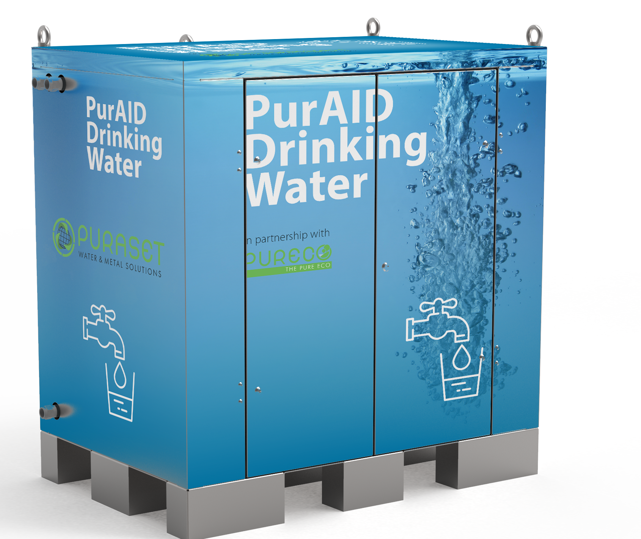
PurAID®- the technology
Chemical free solution
Small environment footprint
Iron, manganese, arsenic, ammonia removal with regenerable adsorbents
Disinfection (viruses) with UV
Modular pallet size solution
Online monitoring
No desalination
Ground water, borehole, network water
Energy efficient
21st African Water Association International Congress & Exhibition and the 7th International Faecal Sludge Management Conference
19-23 February 2023 | Abidjan, Côte d'Ivoire

Slide 8
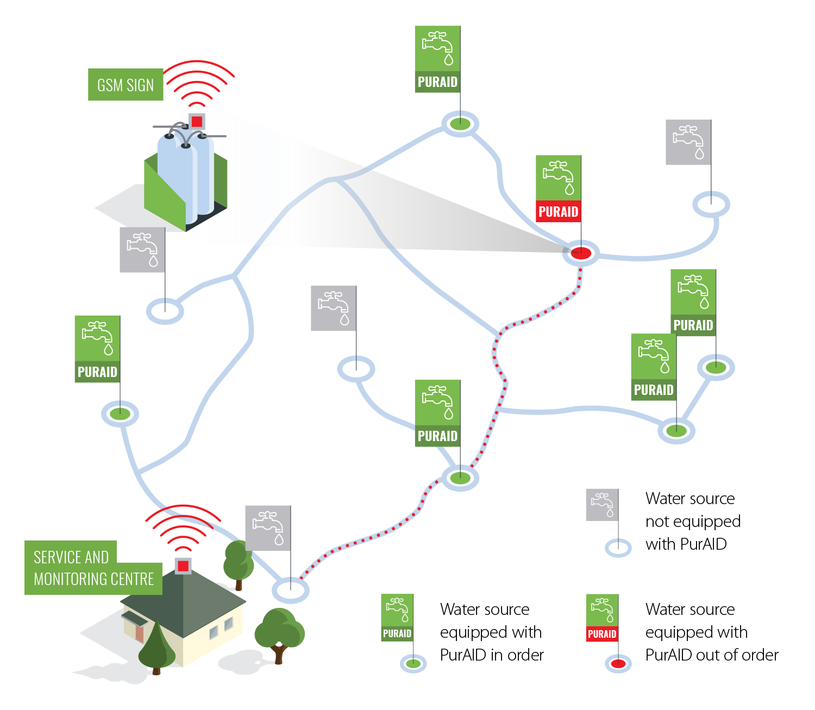
Daily water supply / | 6000- 10,000 Litre
Transport size | max. 800 × 1200 × 2000 mm
Weight | max. 500 kg
Monitoring control system
requires low operation task
21st African Water Association International Congress & Exhibition and the 7th International Faecal Sludge Management Conference
19-23 February 2023 | Abidjan, Côte d'Ivoire

Slide 9
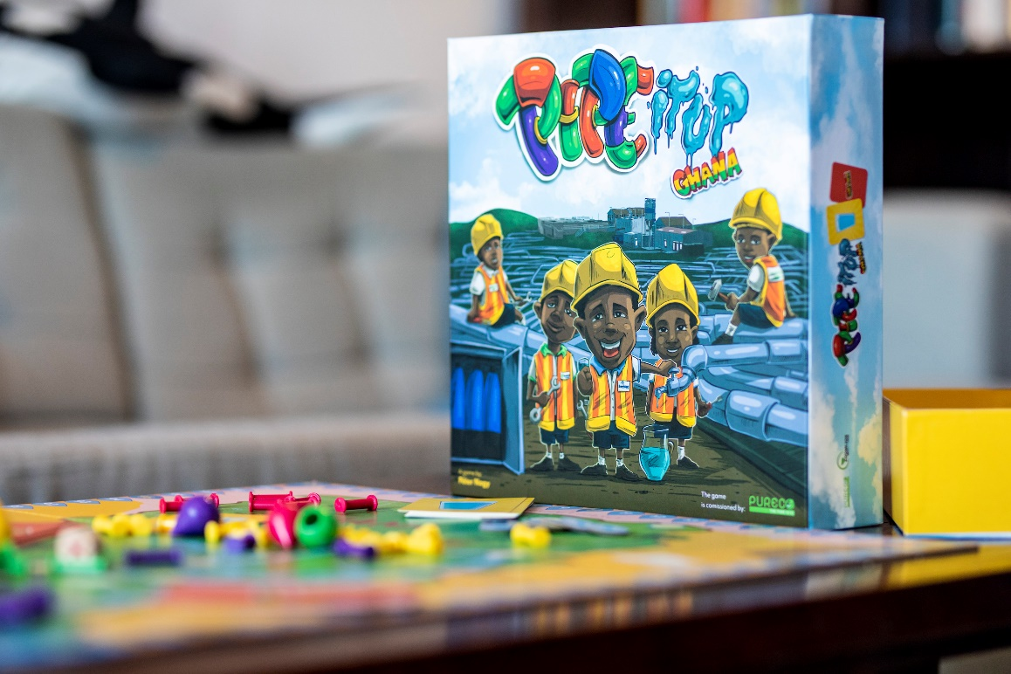
Advantage of the design& technology/ work with PurAID®
No Plastic waste
No Water loss, Revenue water→ forecastable ROI
without high infrastructure investment and network operation cost
Prompt solution for rural communities, settlements without network water, public institutions schools, hospitals
During backwashing, the drinking water supply is continuous. The backwash water can be drained into a rainwater system or filter beds.
School program, education Pipe it up
21st African Water Association International Congress & Exhibition and the 7th International Faecal Sludge Management Conference
19-23 February 2023 | Abidjan, Côte d'Ivoire

Slide 10
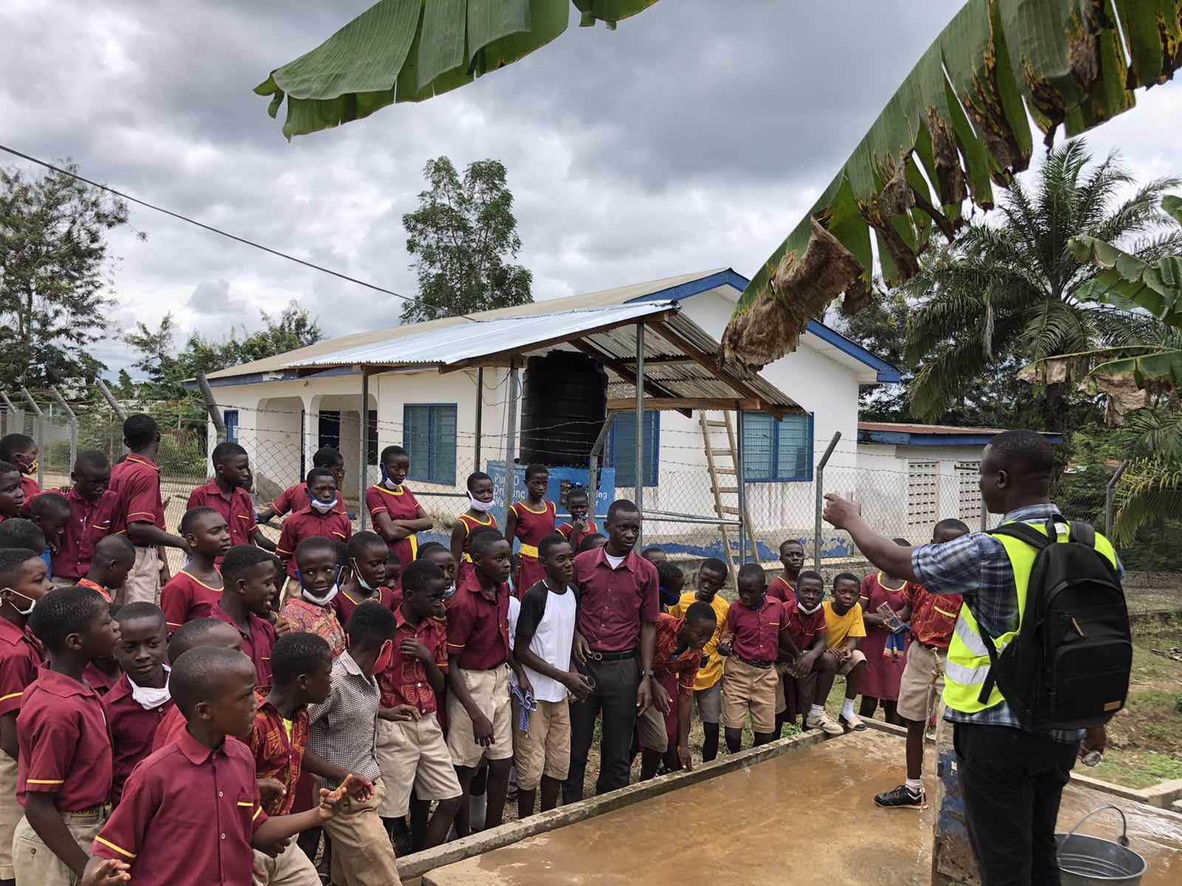
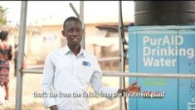
21st African Water Association International Congress & Exhibition and the 7th International Faecal Sludge Management Conference
19-23 February 2023 | Abidjan, Côte d'Ivoire

Slide 11
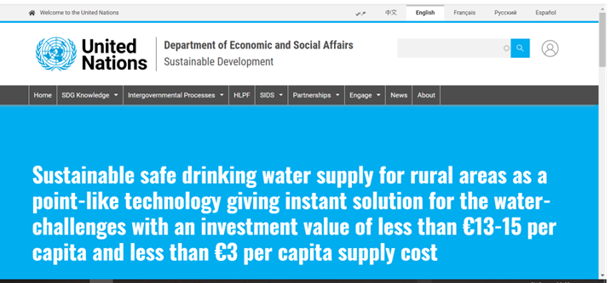
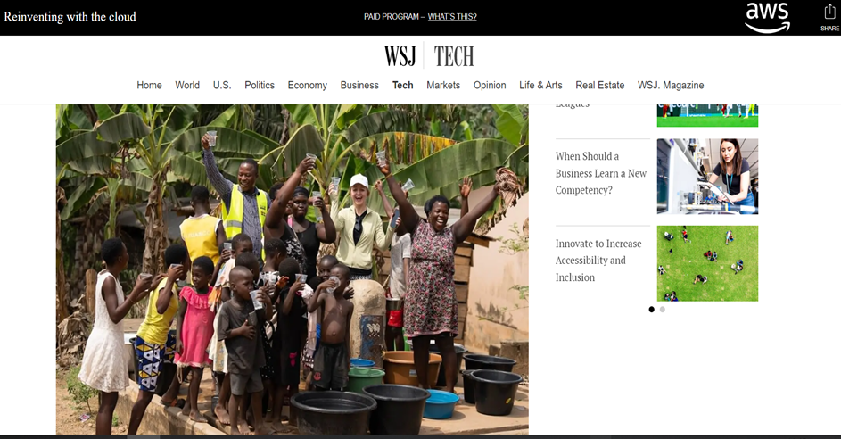
International recognition
Source: https://sdgs.un.org/partnerships/sustainable-safe-drinking-water-supply-rural-areas-point-technology-giving-instant
Source: https://partners.wsj.com/aws/reinventing-with-the-cloud/3-ways-computer-vision-and-iot-can-transform-operations/
21st African Water Association International Congress & Exhibition and the 7th International Faecal Sludge Management Conference
19-23 February 2023 | Abidjan, Côte d'Ivoire

Slide 12
Project in progress:
Akim Wenchi- independent PurAID® water supplier
Installation at a campsite during high way- road construction
Expanding in Africa, Ghana, Ivory Cost, Sierra Leone, Tanzania, Rwanda, Egypt
and worldwide Vietnam, Sri Lanka, Bangladesh
If you are:
SGD committed individual, business entity
Water supplier
Government, Community Leader
Technology supplier, developer for sustainable water supply solutions
Multinational, stake holders active in CSR
21st African Water Association International Congress & Exhibition and the 7th International Faecal Sludge Management Conference
19-23 February 2023 | Abidjan, Côte d'Ivoire

Slide 13
Solution for liquid waste
Solution options | Complete infrastructure cost (€/person) | Per capita supply cost (€/person/year) | Main characteristics
Wastewater management (sewerage and treatment)
According to EU UWWTD 91/271 with main collection and treatment | 1 000 – 4 500 Network from this 800 – 4 000 | 50 – 100 | Discharging and treatment the total quantitiy of wastewater
Wastewater treatment (100% liquid waste) withour sewerage network | < 45 | < 10 | Treatment of the entire volume of wastewater discharged to the surface
Drinking and wastewater / EU | 1 500 – 7 500 | 85 - 170 | Without infrastructure replacement cost
Drinking and wastewater / SDG | < 70 | < 15 | With infrastructure replacement cost
21st African Water Association International Congress & Exhibition and the 7th International Faecal Sludge Management Conference
19-23 February 2023 | Abidjan, Côte d'Ivoire

Slide 14
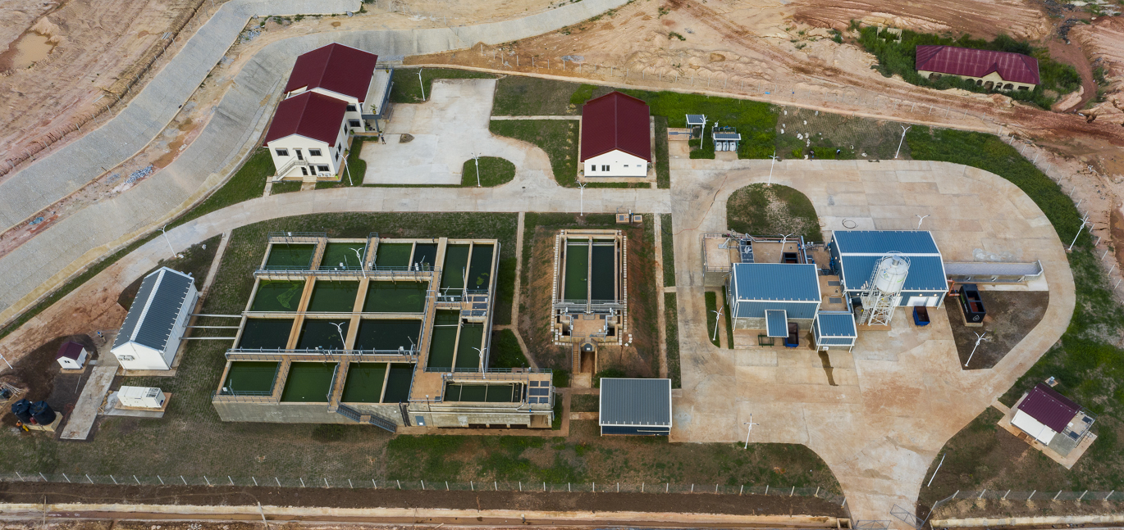
21st African Water Association International Congress & Exhibition and the 7th International Faecal Sludge Management Conference
19-23 February 2023 | Abidjan, Côte d'Ivoire

Slide 15

21st African Water Association International Congress & Exhibition and the 7th International Faecal Sludge Management Conference
19-23 February 2023 | Abidjan, Côte d'Ivoire

Slide 16
Thank you for your kind attention!
Important links:
www.puraset.hu
www.hungarianwaterpartnership.com
https://www.youtube.com/channel/UCvSa-ULjFRB_RNXs1-jZDtA
https://www.linkedin.com/company/puraset-ltd/
21st African Water Association International Congress & Exhibition and the 7th International Faecal Sludge Management Conference
19-23 February 2023 | Abidjan, Côte d'Ivoire

